Slide 1
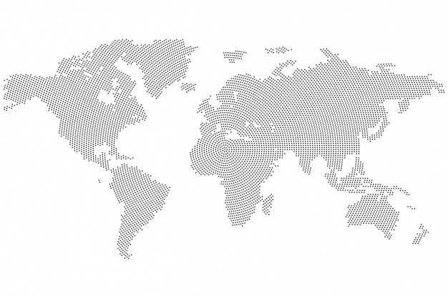
Everything is not as it seems…
Women in Data Hackathon

Slide 2
Raw COVID-19 deaths and raw COVID-19 cases are positively correlated
It is likely that cases and deaths are higher in countries with a large population simply because there are more people to catch the virus
So, how do we know which countries are handling the pandemic well?

Slide 3
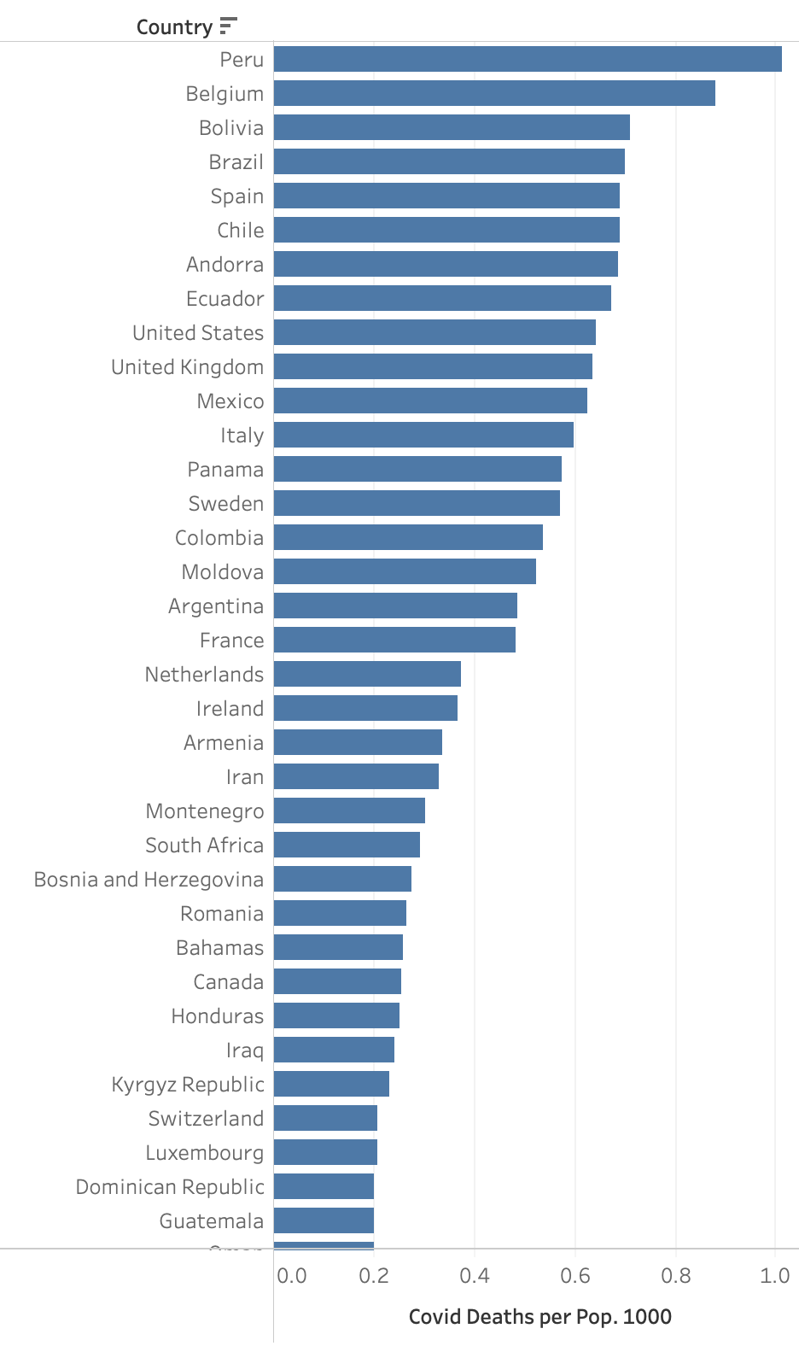
How do we know which countries are handling the pandemic well?
We look at cases and deaths per population instead.

Slide 4
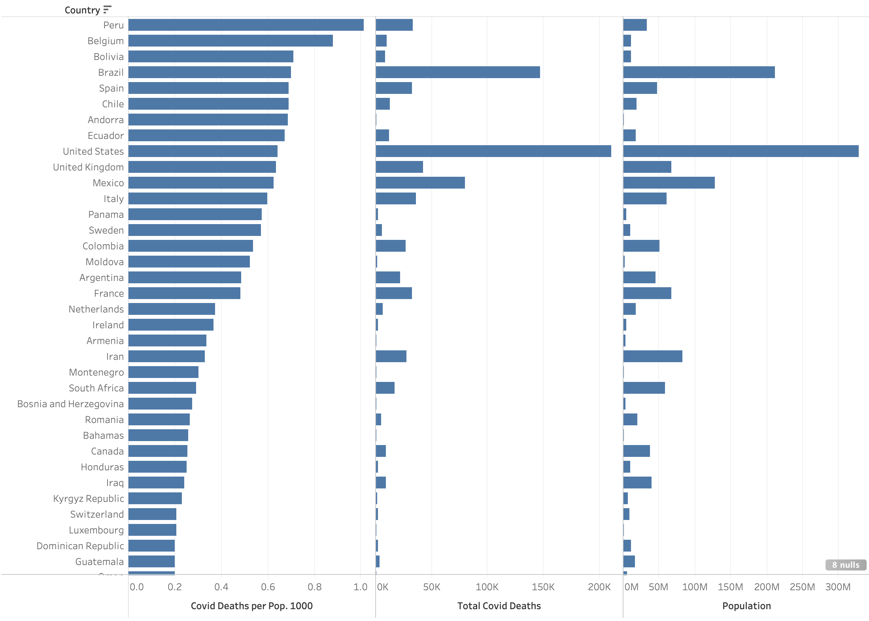
How do we know which countries are handling the pandemic well?
When considering the raw total covid deaths and the raw total population, our theory seems to hold well. It appears that the larger the population, the larger the number of deaths

Slide 5
But is it fair to compare small countries to large countries?
Normalising the data in this way can be misleading. When normalizing by size of population, small countries such as Belgium and Andorra need only a small increase in raw deaths to make a huge impact on their death/population metric.
i.e. small countries are more sensitive to this metric than larger countries. Their high cases and deaths per population, most likely due to their small population.

Slide 6
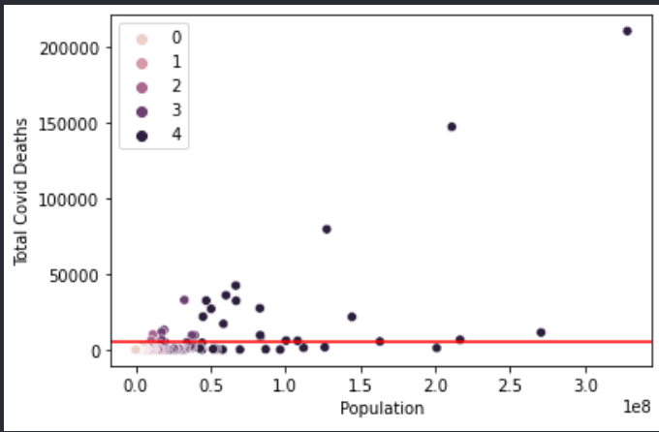
But is it fair to compare small countries to large countries?
The challenges faced and strategies employed will also be very different between small and large countries.
It may be easier to enforce travel restrictions and internal movement on a small central country with the use of a central force, rather than in a large country where there may be dependencies on federated forces (states and counties).

Slide 7
An alternative way to measure?
Instead, we chose to compare deaths and cases of countries of similar sizes, and to their land neighbours to have a greater understanding of their performance relative to countries of the same size.

Slide 8
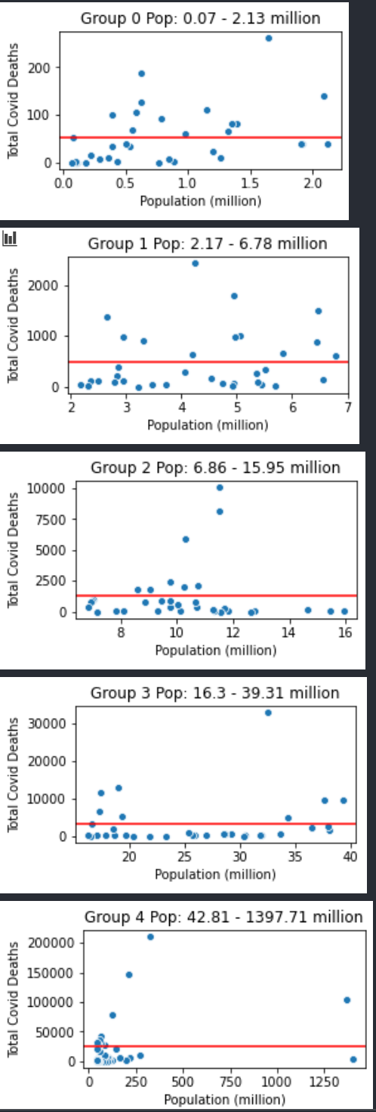
…SO we segregated the data by population size
5 groups, equal number of countries in each group

Slide 9

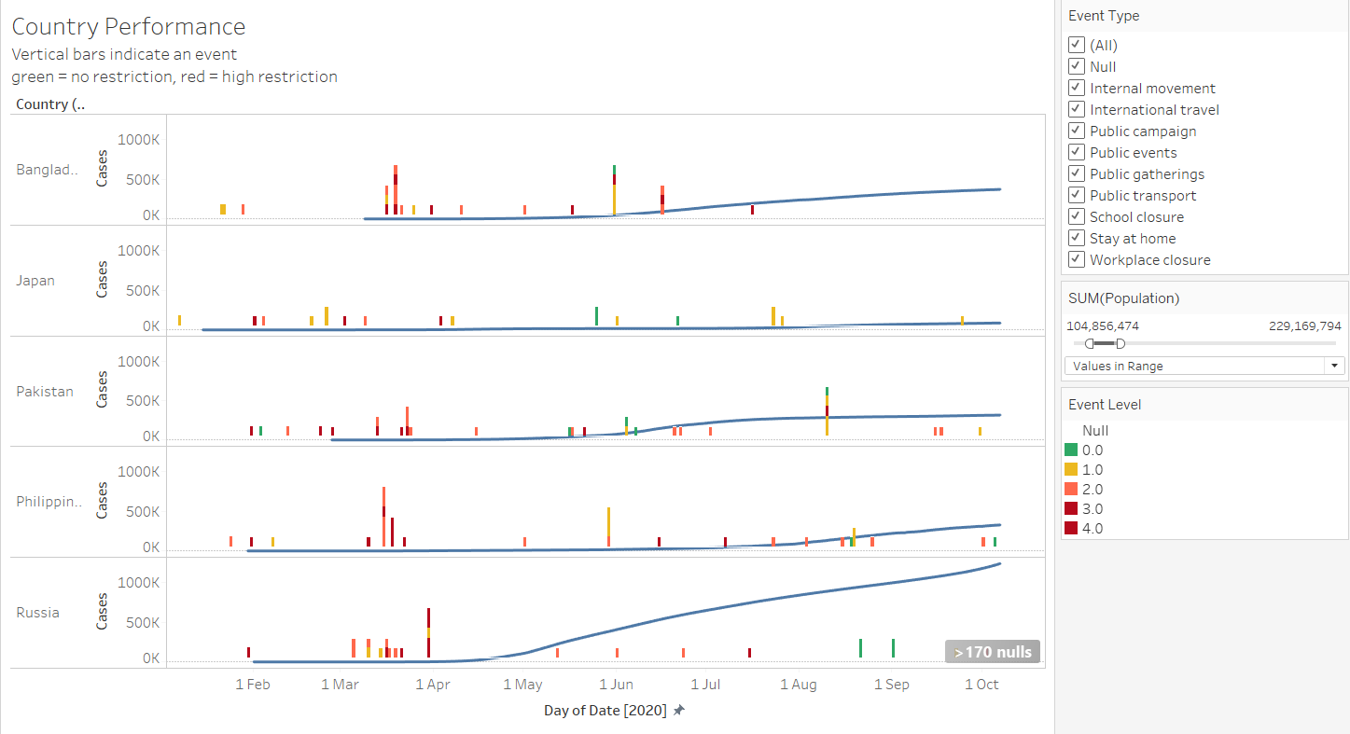
More data. Bring it on !!!
There were still some countries in the same population size group that had higher cases…So we brought in the lockdown restrictions data and looked at the influence those had on the rise in the country’s cases and deaths per population?
Insights – Russia had more cases than it’s counterparts within the same population size group and it is highly likely that’s due to the fact that it started relaxing the restrictions since May and none after August 2020, whereas the other countries continued to have some level of restrictions in place.

Slide 10

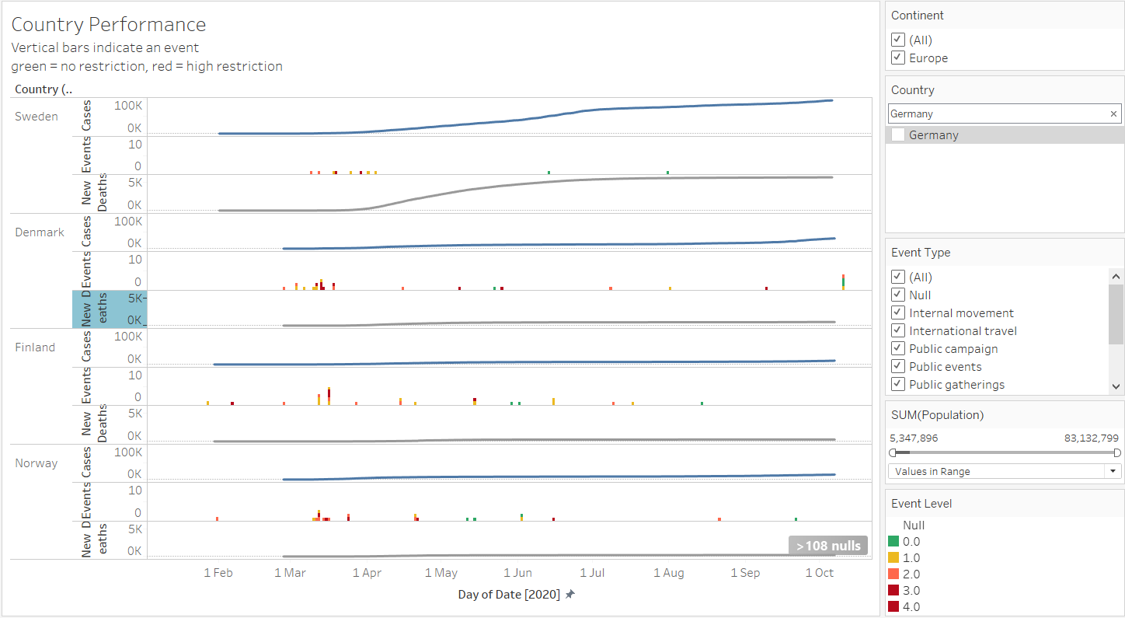
How about Sweden ? - the most talked about country for it’s strategy to tackle COVID-19. Has its no-lockdown strategy back-fired ?
…And our answer to the question is “Yes”. When compared to its Nordic neighbours, Sweden had steep rise in new cases as well as deaths since May 2020 and with no restrictions in place, whereas its neighbouring countries have been able to keep the new cases at low and reduction in deaths.

